Slide 1


Slide 2
table of contents
what is Shit Ticket
IPERKA
demo
open problems to solve

Slide 3
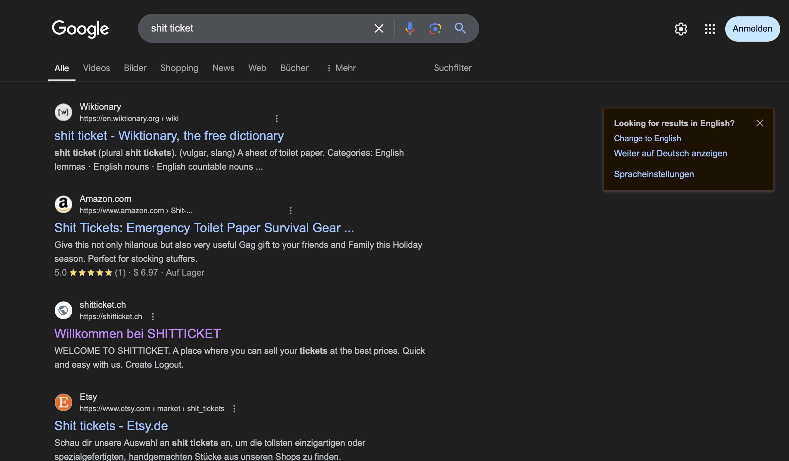
Shit Ticket
MVP ticketing system for small to medium events
Why this name?

Slide 4
IPERKA
Inform
Plan
Decide
Realization backend
Realization frontend
Realization design
Control
Evaluation

Slide 5

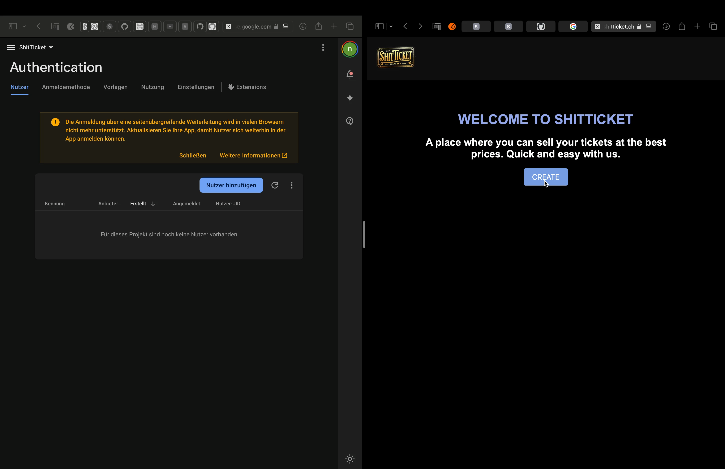
Demo
If internet doesn’t work

